Slide 1
IP addresses
The lecture 4

Slide 2
IPv4 Addresses

Slide 3
Static vs Automatic Addressing

Slide 4
IPv4 Address Octets

Slide 5
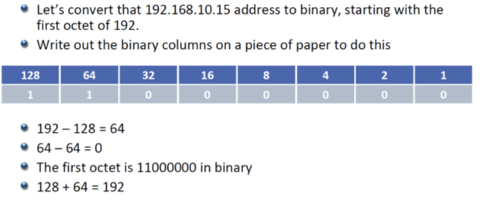
Converting First Octet to Binary

Slide 6
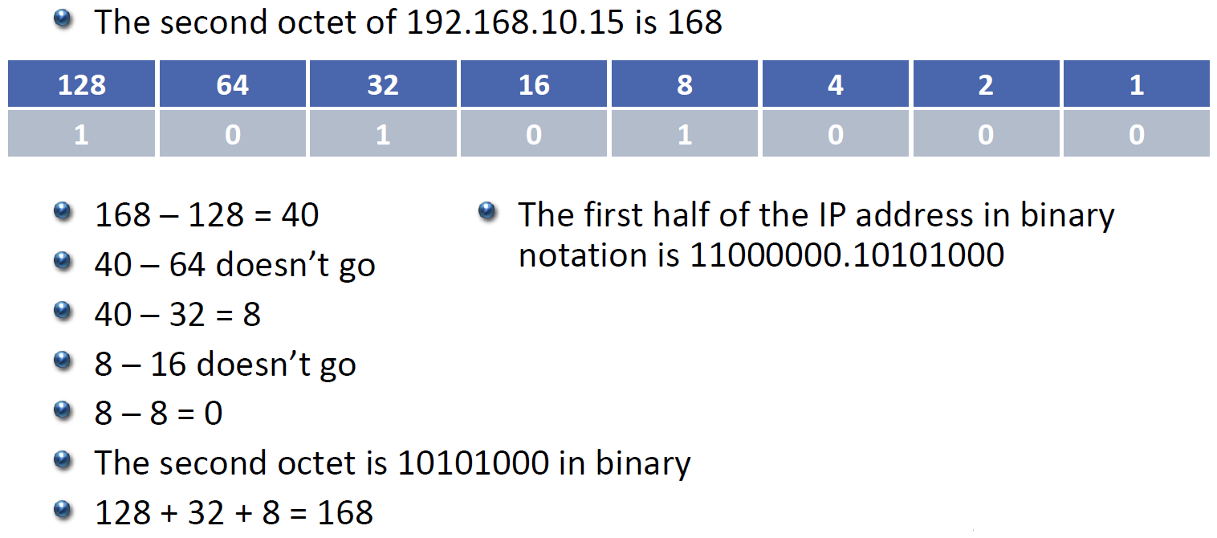
Converting Second Octet to Binary

Slide 7
Converting Decimal to Binary

Slide 8
Conversion Answer

Slide 9
Subnet Masks

Slide 10
The Subnet Mask

Slide 11
Network and Host Portion

Slide 12
Subnet ‘Masking’

Slide 13
The Network Portion

Slide 14
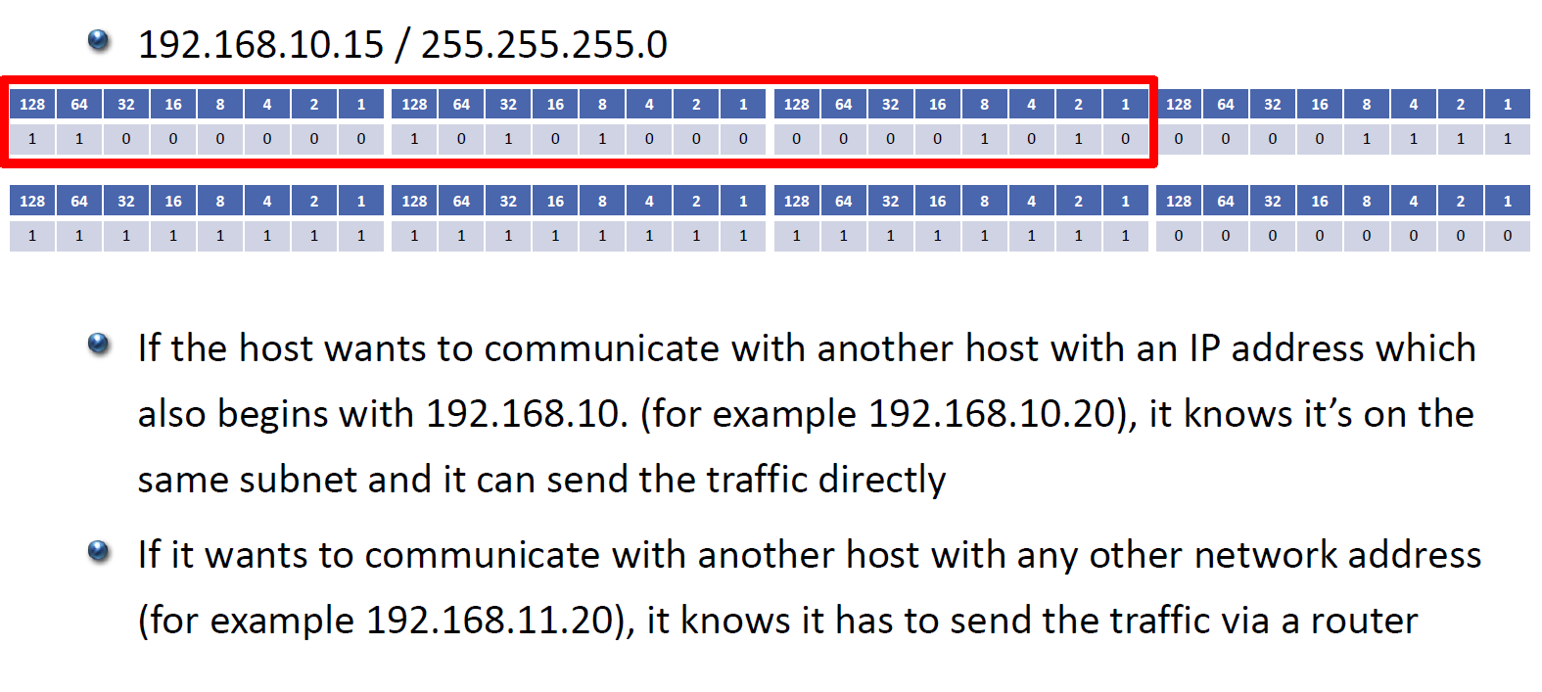
Local Subnet or Routed Traffic

Slide 15
Local Subnet or Routed Traffic

Slide 16
Valid Subnet Masks

Slide 17
The Host Portion

Slide 18
Host Addresses

Slide 19
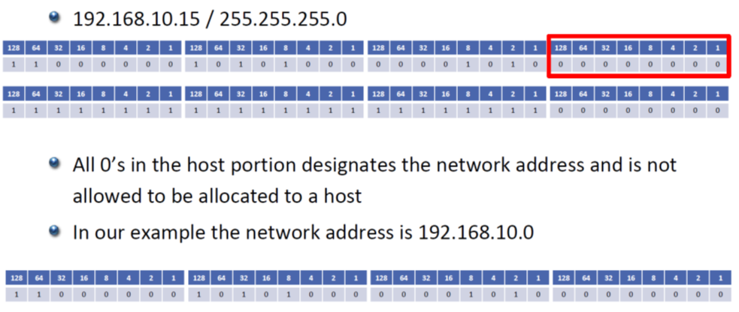
The Network Address (Network ID)

Slide 20
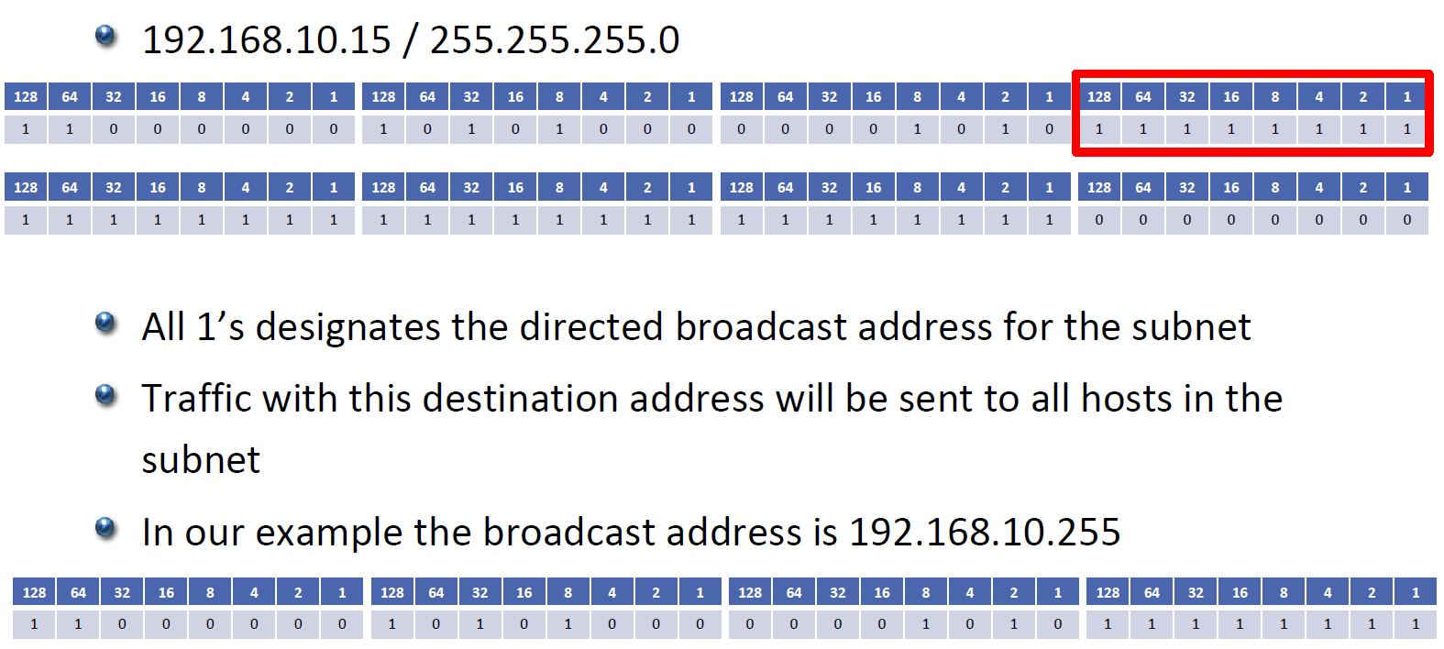
The Broadcast Address

Slide 21
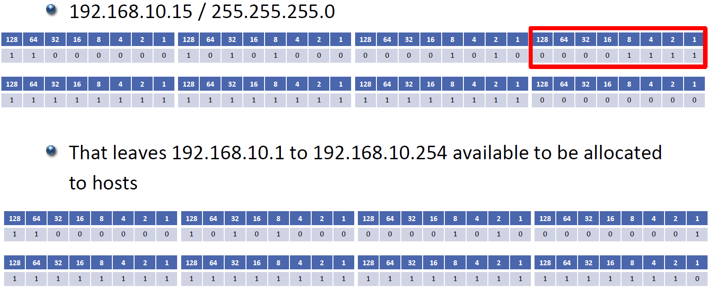
Host Addresses

